Slide 1
Quantum Algorithms: QAOA and NP-hard Problems
Emil Khusainov
Reviser: Burak Mete
06. Dezember 2024

Slide 2
Two Types of classical algorithms
Algorithms with proven performance
Performance proved mathematically or analytically. Give an exact the best solution or proven close to the best.
Often resource-intensive, that’s why we use them when we need more quality than speed
Example:
Dijkstra
Simple math arithmetic

Slide 3
Two Types of classical algorithms
Algorithms with proven performance
Performance proved mathematically or analytically. Give an exact the best solution or proven close to the best.
Often resource-intensive, that’s why we use them when we need more quality than speed
Example:
Dijkstra
Simple math arithmetic
Heuristic methods
using some approximations and simplifications to provide not the best result, but a good one and much faster than analogous proven performance
no proves that the solution will be in some range from the best
Give the result here and now, often the most powerful algorithms we know
Example:
Simulated annealing
Almost all molecular or genetic algorithms

Slide 4
Quantum analogous
We hope that in quantum world this division also apply
Algorithms with proven performance
Shor‘s algorithm of integer factorization
Grover‘s algorithm of unstructured search

Slide 5
Quantum analogous
We hope that in quantum world this division also applicable
Algorithms with proven performance
Shor‘s algorithm of integer factorization
Grover‘s algorithm of unstructured search
Heuristic methods
Quantum annealing
Quantum approximation optimization algorithm (QAOA)

Slide 6
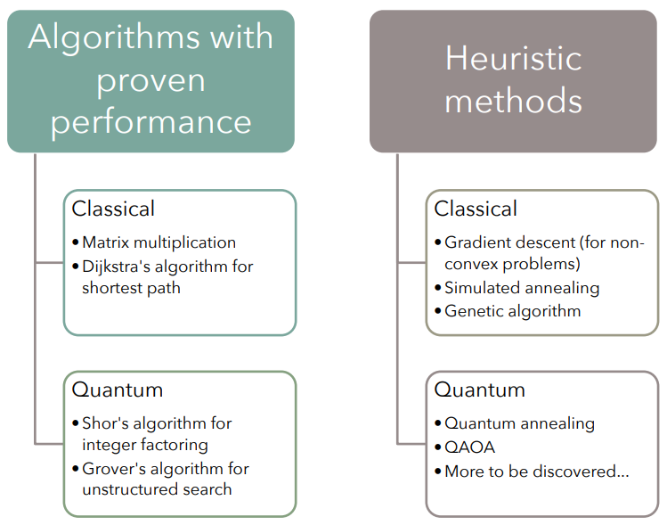
Quantum analogous
We hope that in quantum world this division also applicable
Algorithms with proven performance
Shor‘s algorithm of integer factorization
Grover‘s algorithm of unstructured search
Heuristic methods
Quantum annealing
Quantum approximation
optimization algorithm (QAOA)
https://github.com/rsln-s/IEEE_QW_2020/

Slide 7
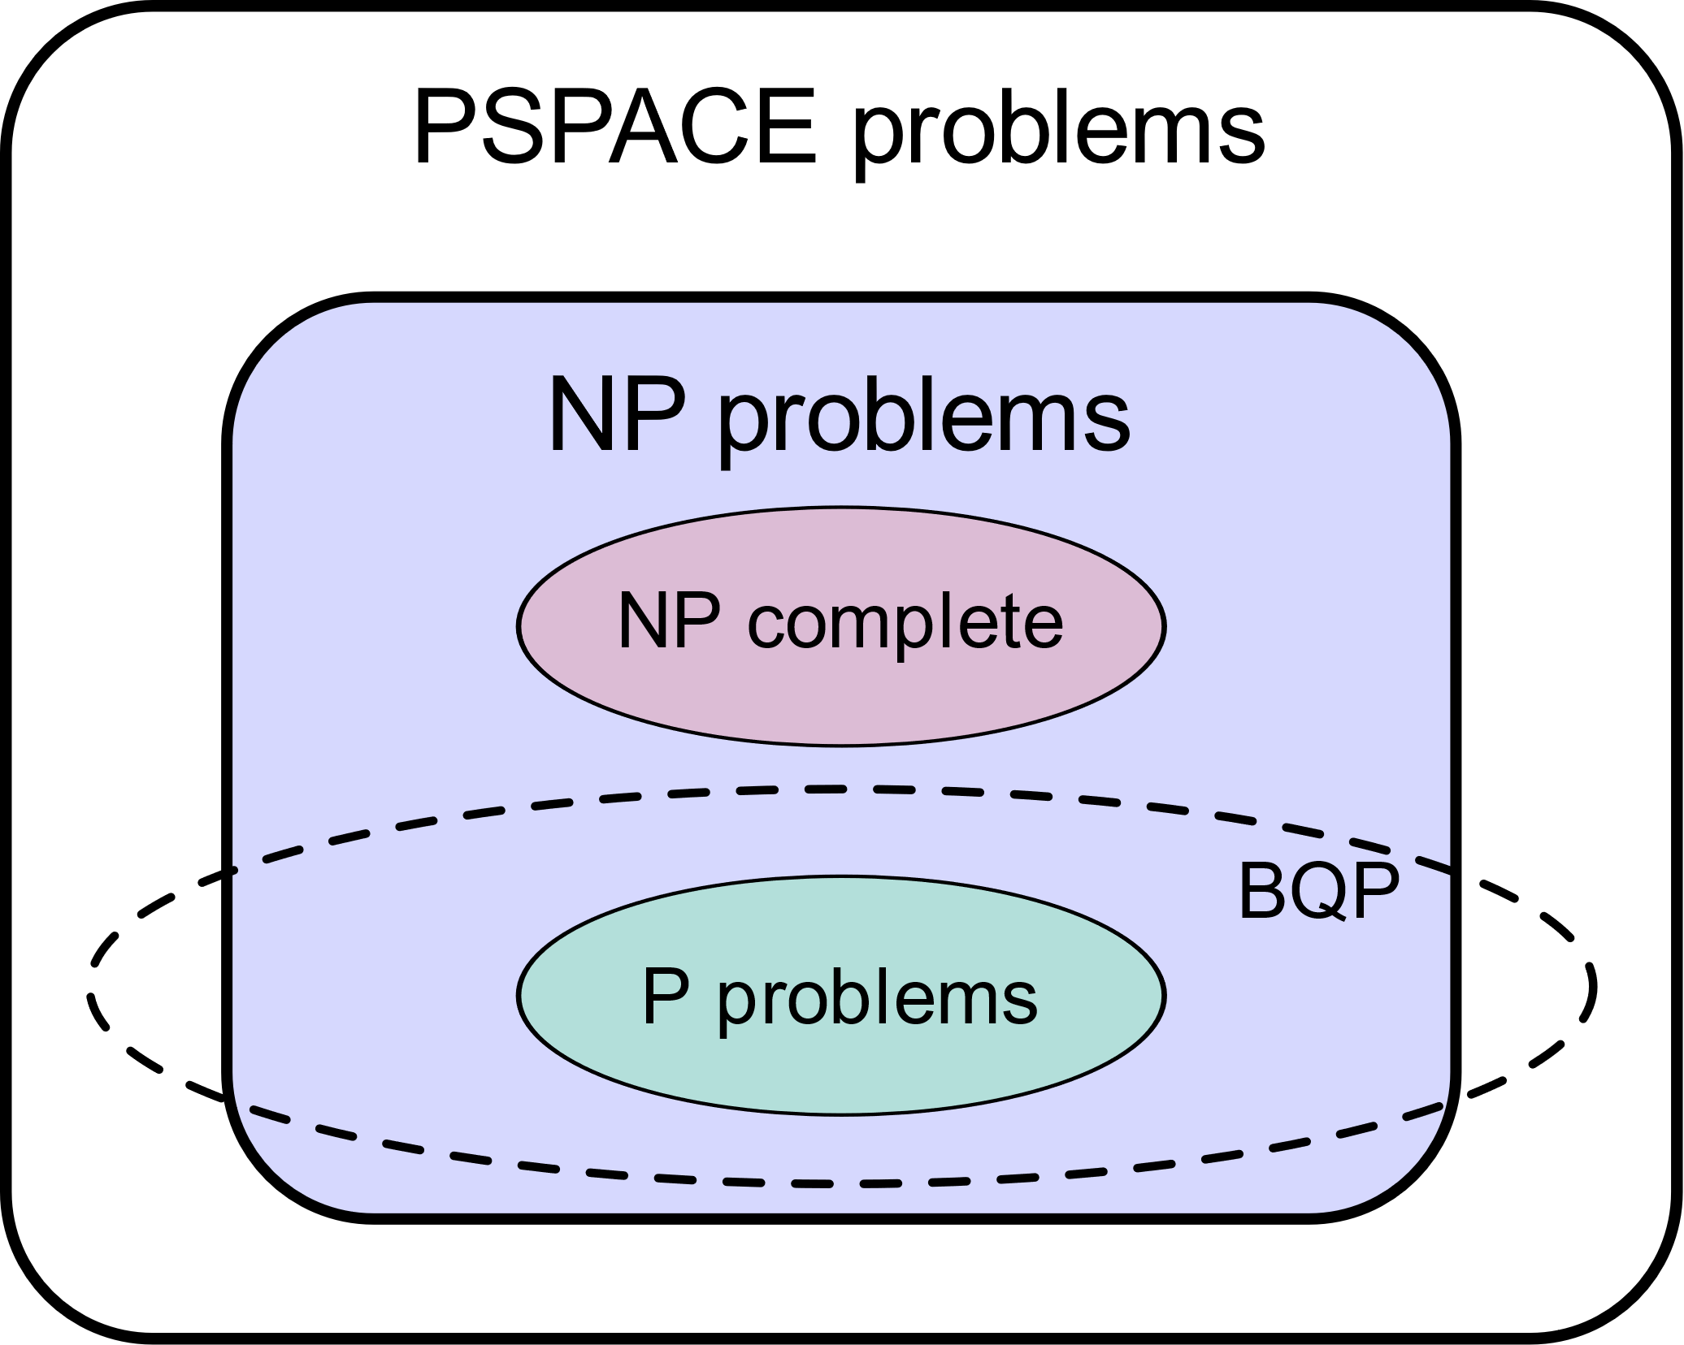
Quantum Algorithm Complexity (BQP)
BQP (bounded error, quantum, polynomial time) is the class of problems that can be solved by a polynomial-time quantum Turing machine with error probability of at most 1/3
We know that P is a subset of BQP (but don’t know if it is a strict subset)
The most interesting is a relationship between NP and BQP
Suspected that BQP and NP-complete are disjoint
https://en.wikipedia.org/wiki/BQP

Slide 8
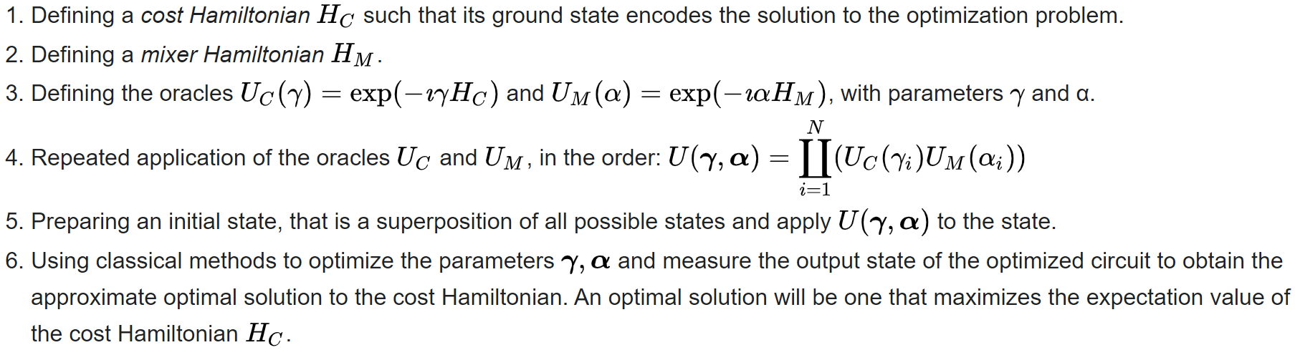
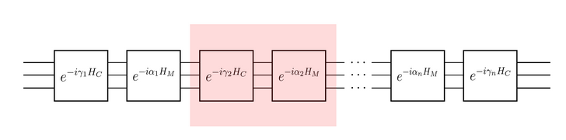
Quantum heuristic Algorithm QAOA
https://en.wikipedia.org/wiki/Quantum_optimization_algorithms

Slide 9
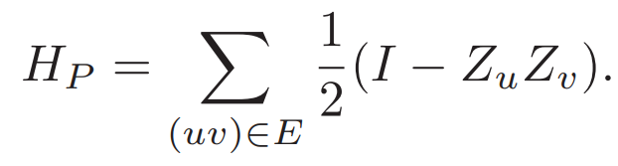
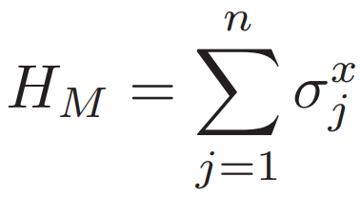
Quantum heuristic Algorithm QAOA
Cost Hamiltonian(also Phase Hamiltonian) is needed to encoding the objective function of our problem that need to be minimized or maximized and it fixes the right solution
In case of MaxCut it equals to:
Mixer Hamiltonian is used to explore a variety of possible solutions in order to avoid local minima and achieve a global optimum.
In almost every case : , where omega-x is a Pauli-X gate for j-th qubit
More about the determination and purpose of Hamiltonians will be told from another student today

Slide 10
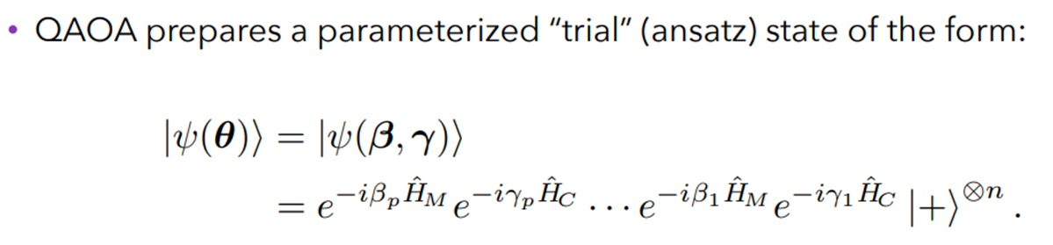
Quantum heuristic Algorithm QAOA

Slide 11
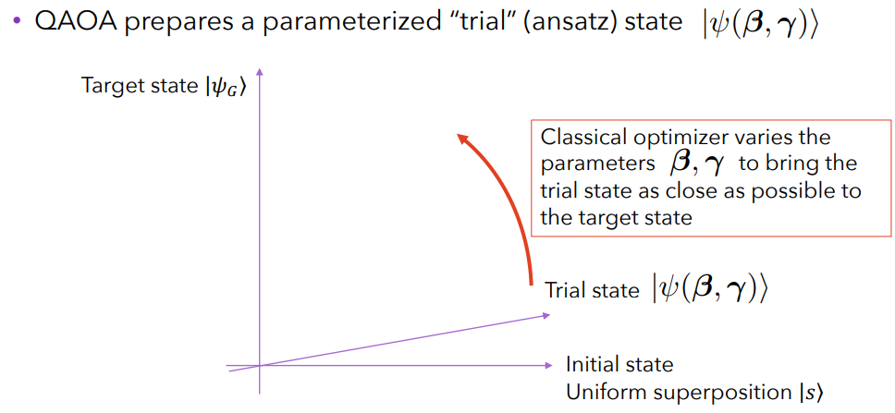
Quantum heuristic Algorithm QAOA
Then we use a classical optimizer to determine Beta und Gamma parameters
https://ieeexplore.ieee.org/abstract/document/8939749

Slide 12
Characteristics of QAOA
First of all we should define a p for our problem, it is essential and has a lot of consequences such as number of applications of Hamiltonians and number of parameter to optimize
Big p gives more precise solution but needs significantly more resources for each layer,
when p is tending to infinity then QAOA is equal to Adiabatic Quantum Computation
Dependency on Real NISQ:
Big p cannot be used because of noises
Dependency on classical part
Optimization of increasing number parameters is getting harder

Slide 13
Let‘s see on example graphs, how the solution from QAOA differs from the best by different p
Important:
increasing number of p increases resource usage of simulation
Increasing number of nodes in graph by one increases number of qubits by one, but for simulation it is a exponentially growth in resource
I will use random generator for start optimization values and „COBYLA“ as optimizer
I will iterate over all possible values on my primitive MaxCut solver implementation to get the best solution and to compare it with QAOA result on different p
Graphs are static

Slide 14
Let‘s see on example graphs, how the solution from QAOA differs from the best by different p
Important:
increasing number of p increases resource usage of simulation
Increasing number of nodes in graph by one increases number of qubits by one, but for simulation it is a exponentially growth in resource
I will use random generator for start optimization values and „COBYLA“ as optimizer
I will iterate over all possible values on my primitive MaxCut solver implementation to get the best solution and to compare it with QAOA result on different p
Graphs are static
Here are my Graphs

Slide 15
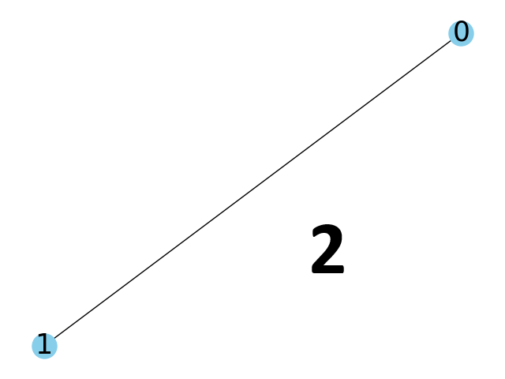
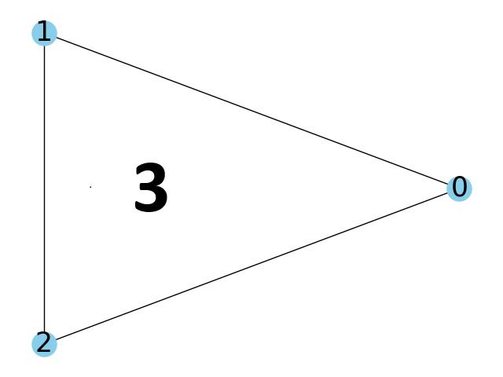
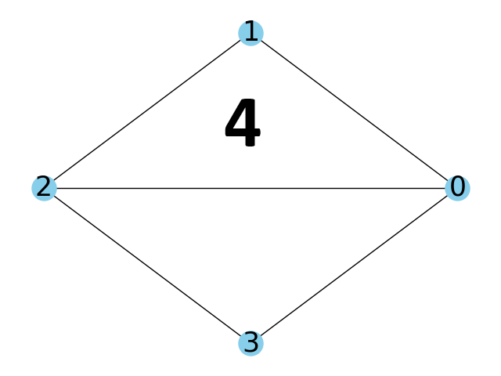
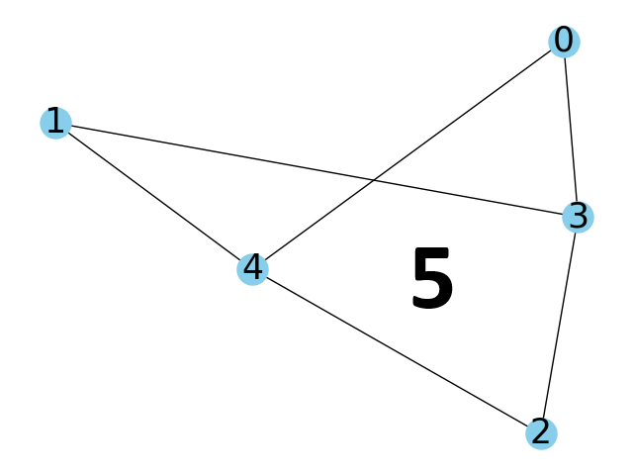
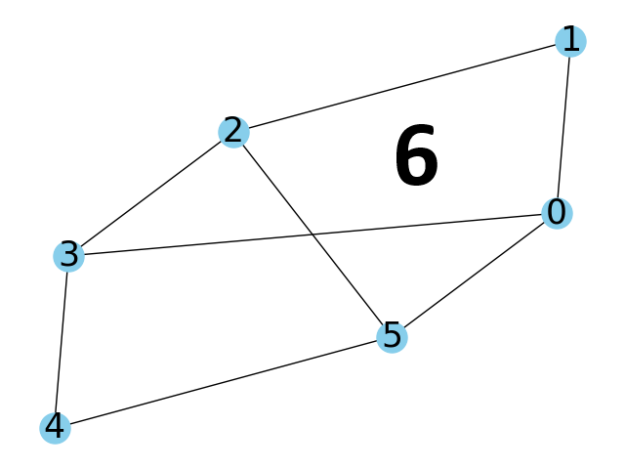
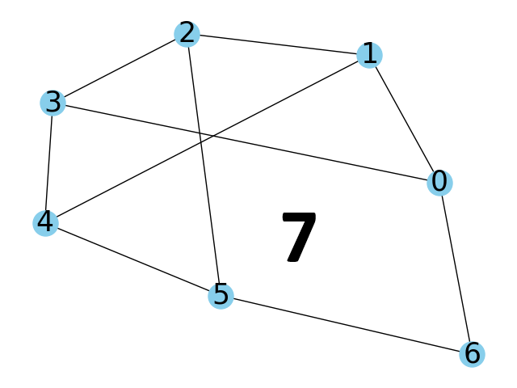
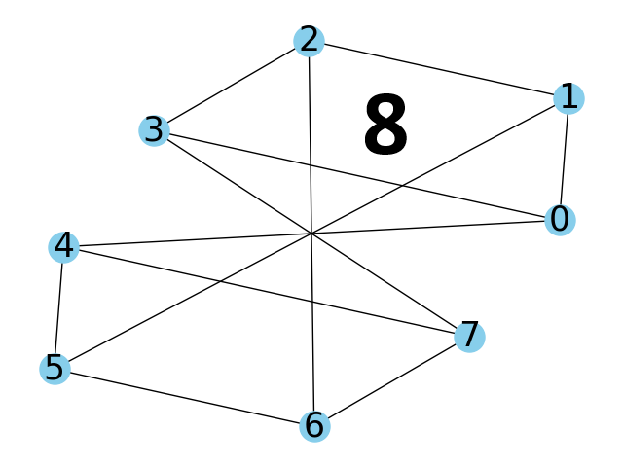
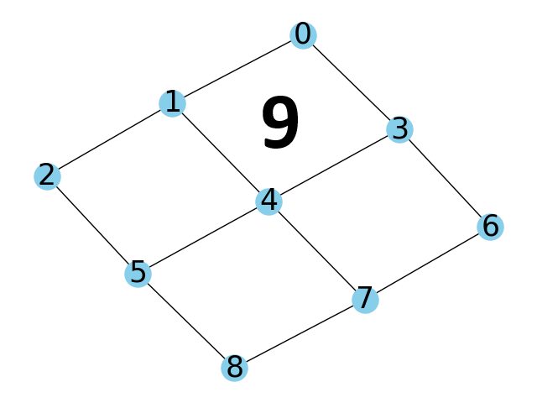
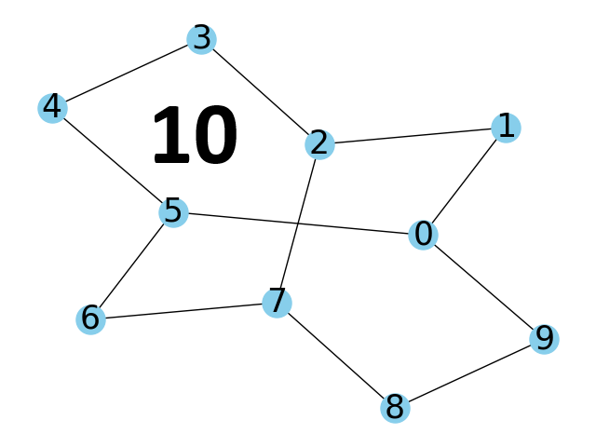
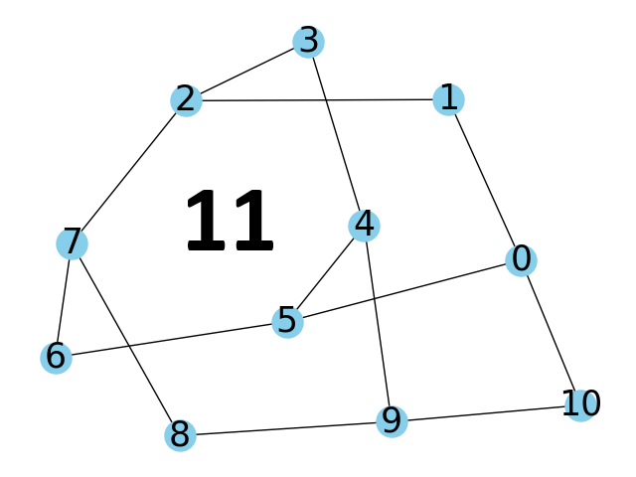
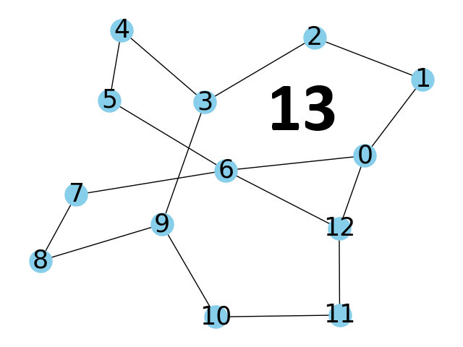
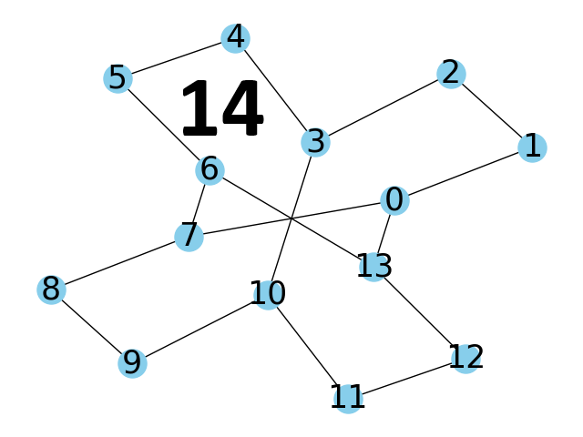
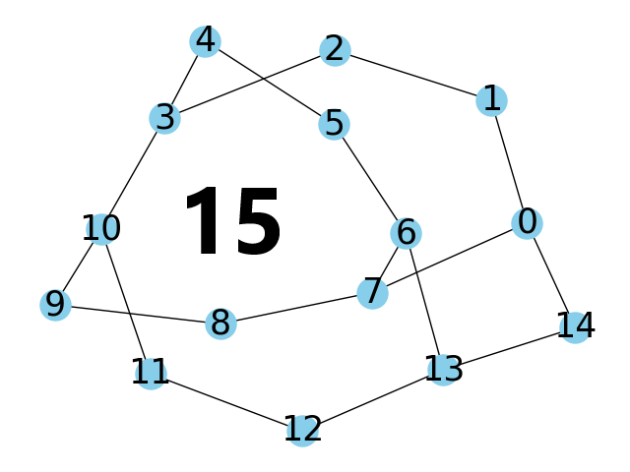
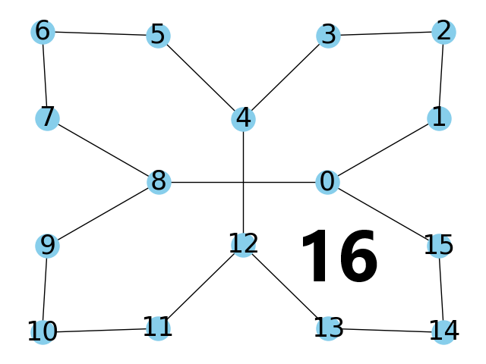
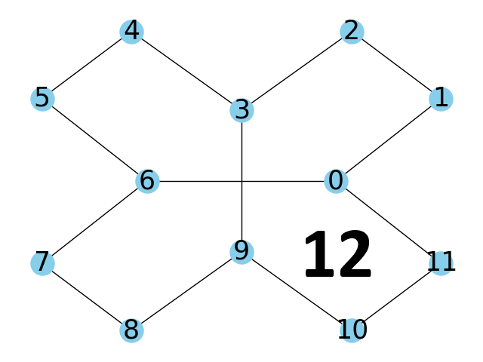
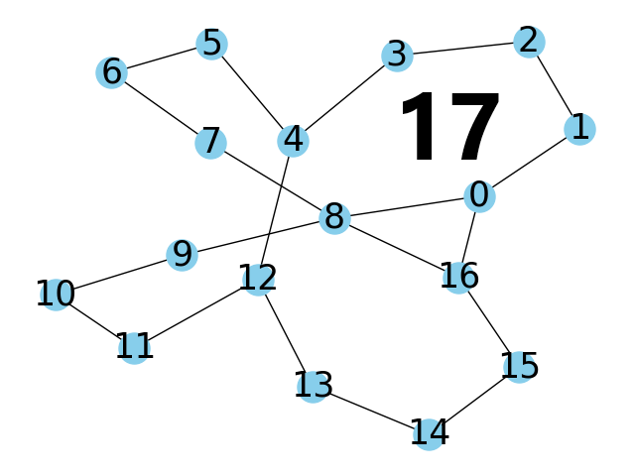
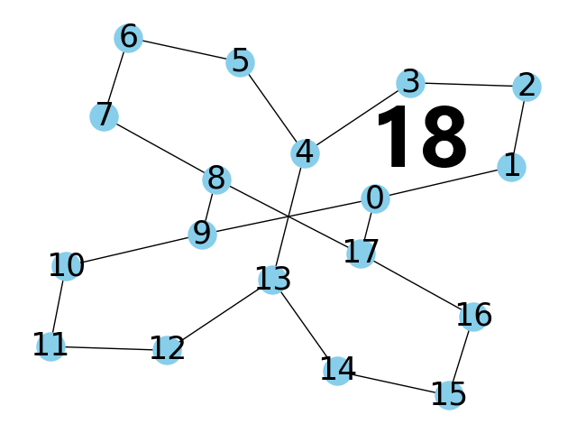
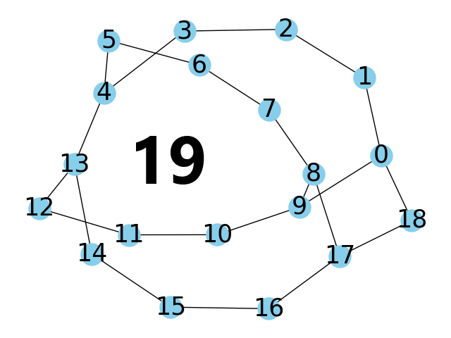

Slide 16
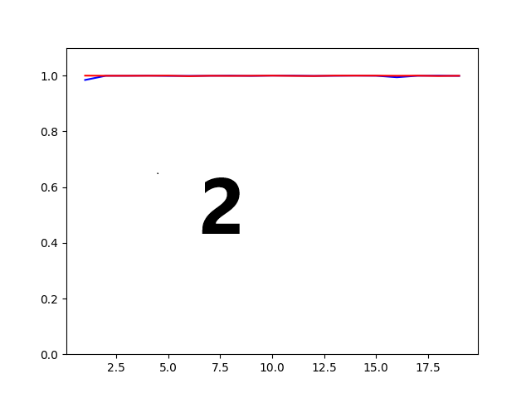
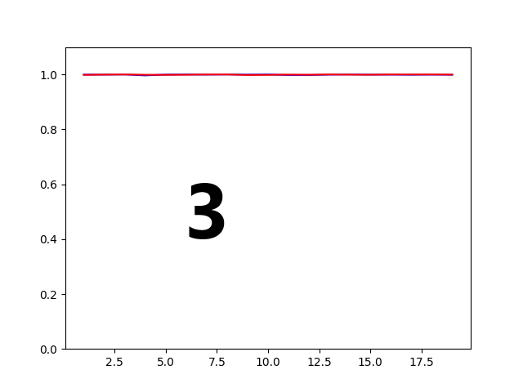
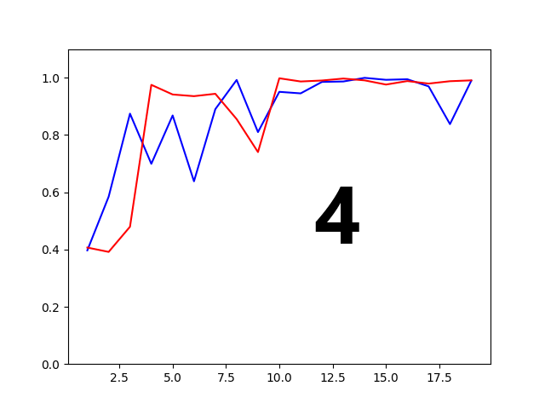
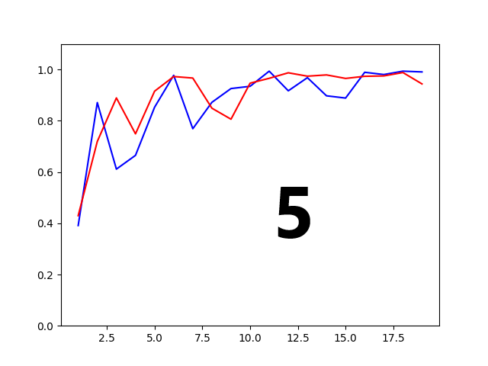
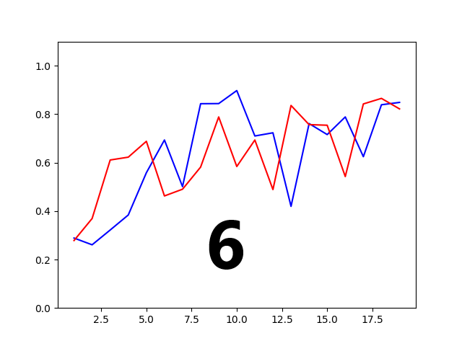
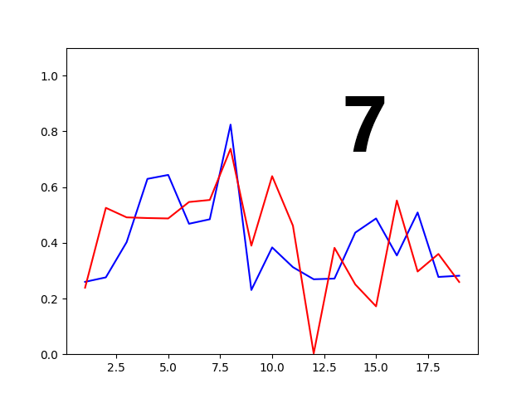
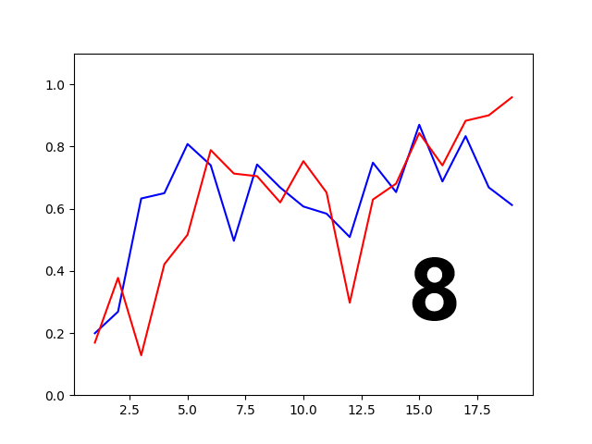
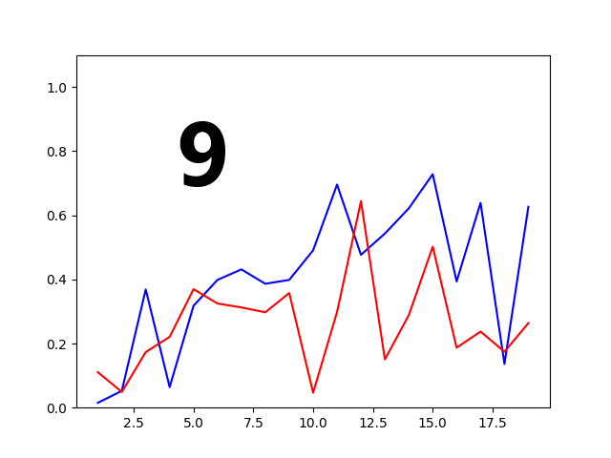
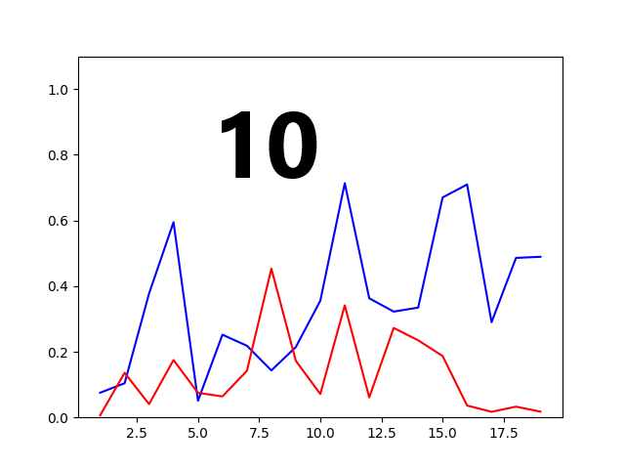
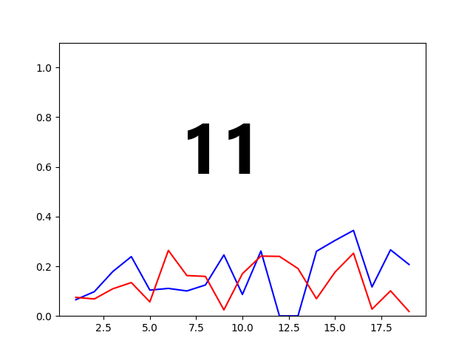
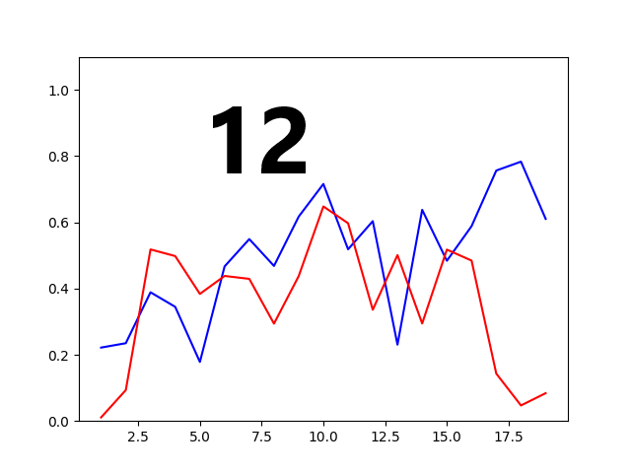
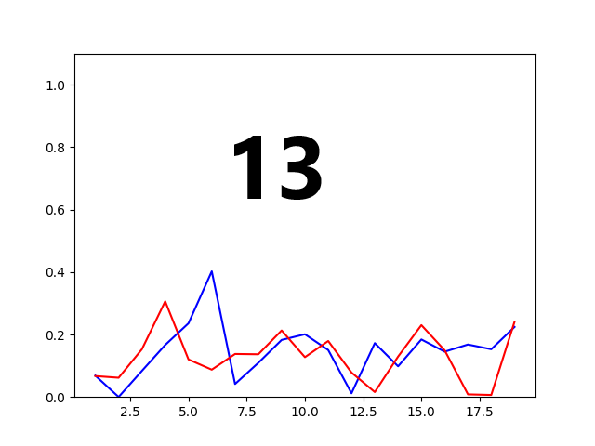
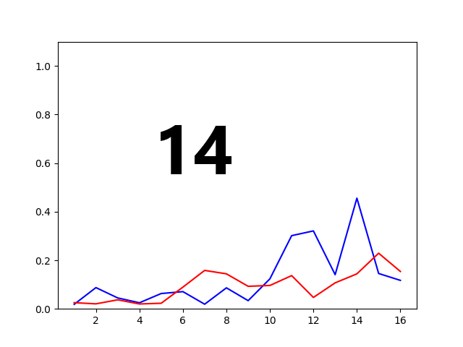
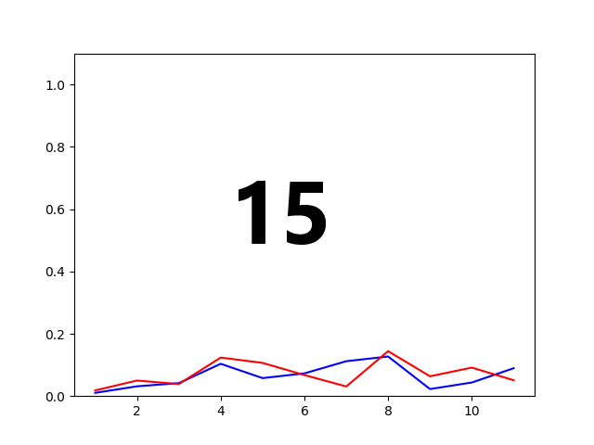
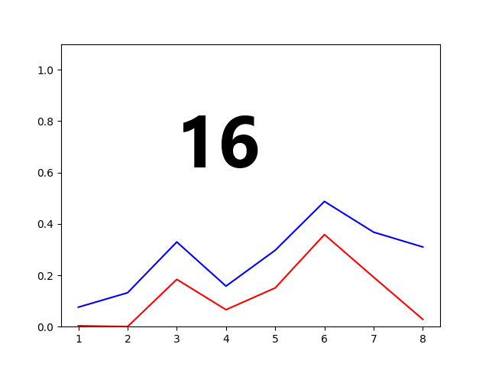
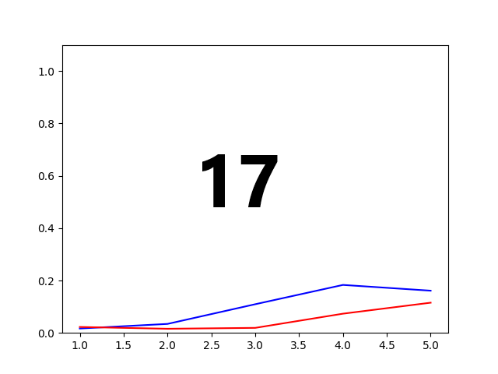
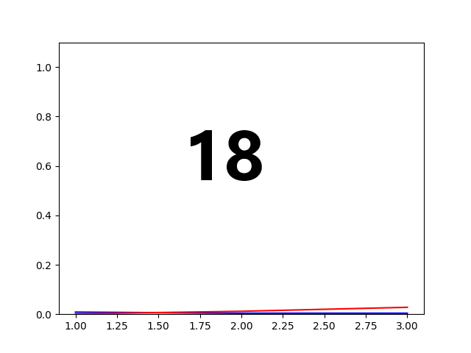
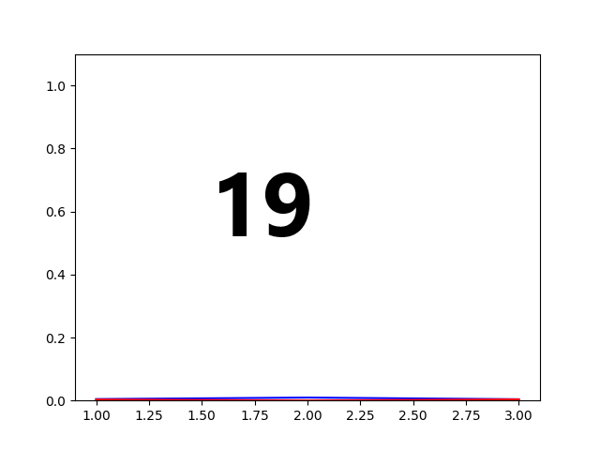
Blue is second run with saving p and red is by first run with random p y-axis is probability from 0 bis 1 of the best solution in all graphs, x is number p, for 2-13 it is until 20 and from 14 is written under
16 11 8 5 3 3

Slide 17
Сonclusion
It is hard to optimize a lot of thetas
Chose of p is very important
Probability is small by big graphs, but very big by comparison with solution space
Increasing number of qubits will produce exponential growth and it is hard to simulate

Slide 18
Links
https://ieeexplore.ieee.org/abstract/document/8939749
https://github.com/rsln-s/IEEE_QW_2020/

